Slide 1

Machine Learning & Data Mining CS/CNS/EE 155
Lecture 4:
Recent Applications of Lasso

Slide 2
Today: Two Recent Applications
Personalization
via twitter
Cancer Detection
Applications of Lasso (and related methods)
Think about the data & modeling goals
Some new learning problems
Slide material borrowed from Rob Tibshirani and Khalid El-Arini
Image Sources: http://www.pnas.org/content/111/7/2436
https://dl.dropboxusercontent.com/u/16830382/papers/badgepaper-kdd2013.pdf

Slide 3
Aside: Convexity
Not Convex
Easy to find
global optima!
Strict convex if
diff always >0
Image Source: http://en.wikipedia.org/wiki/Convex_function

Slide 4
Aside: Convexity
All local optima are global optima:
Strictly convex: unique global optimum:
Almost all objectives discussed are (strictly) convex:
SVMs, LR, Ridge, Lasso… (except ANNs)

Slide 5
Cancer Detection

Slide 6
“Molecular assessment of surgical-resection margins
of gastric cancer by mass-spectrometric imaging”
Proceedings of the National Academy of Sciences (2014)
Livia S. Eberlin, Robert Tibshirani, Jialing Zhang, Teri Longacre, Gerald Berry,
David B. Bingham, Jeffrey Norton, Richard N. Zare, and George A. Poultsides
http://www.pnas.org/content/111/7/2436
http://statweb.stanford.edu/~tibs/ftp/canc.pdf
Gastric (Stomach) Cancer
Surgeon removes tissue
Pathologist examines tissue
Under microscope
If no margin, GOTO Step 1.
Image Source: http://statweb.stanford.edu/~tibs/ftp/canc.pdf

Slide 7
Drawbacks
Expensive: requires a pathologist
Slow: examination can take up to an hour
Unreliable: 20%-30% can’t predict on the spot
Gastric (Stomach) Cancer
Surgeon removes tissue
Pathologist examines tissue
Under microscope
If no margin, GOTO Step 1.
Image Source: http://statweb.stanford.edu/~tibs/ftp/canc.pdf

Slide 8
Machine Learning to the Rescue! (actually just statistics)
Lasso originated from statistics community.
But we machine learners love it!
Train a model to predict cancerous regions!
Y = {C,E,S} (How to predict 3 possible labels?)
What is X?
What is loss function?
Basic Lasso:

Slide 9
Mass Spectrometry Imaging
DESI-MSI (Desorption Electrospray Ionization)
Effectively runs in real-time (used to generate x)
http://en.wikipedia.org/wiki/Desorption_electrospray_ionization
Image Source: http://statweb.stanford.edu/~tibs/ftp/canc.pdf

Slide 10
Each pixel is data point
x via spectroscopy
y via cell-type label
x
Image Source: http://statweb.stanford.edu/~tibs/ftp/canc.pdf

Slide 11
x
Each pixel has
11K features.
Visualizing a
few features.
Image Source: http://statweb.stanford.edu/~tibs/ftp/canc.pdf

Slide 12
Multiclass Prediction
Multiclass y:
Most common model:
Loss function?
Replicate Weights:
Score All Classes:
Predict via Largest Score:

Slide 13
Multiclass Logistic Regression
Binary LR:
“Log Linear” Property:
(w₁,b₁) = (-w₋₁,-b₋₁)
Keep a (w_{k},b_{k})
for each class
Extension to Multiclass:
Multiclass LR:
Referred to as Multinomial Log-Likelihood by Tibshirani
http://statweb.stanford.edu/~tibs/ftp/canc.pdf

Slide 14
Multiclass Log Loss

Slide 15
Multiclass Log Loss
Suppose x=1 & ignore b
Model score is just w_{k}
Vary one weight, others = 1
y=k
Log Loss
y≠k

Slide 16
Lasso Multiclass Logistic Regression
Probabilistic model
Sparse weights

Slide 17
Back to the Problem
Image Tissue Samples
Each pixel is an x
11K features via Mass Spec
Computable in real time
1 prediction per pixel
y via lab results
~2 weeks turn-around
Visualization of all
pixels for one feature
x

Slide 18
Learn a Predictive Model
Training set: 28 tissue samples from 14 patients
Cross validation to select λ
Test set: 21 tissue samples from 9 patients
Test Performance:
≥0.2 margin
in probability

Slide 19
Lasso yields sparse weights! (Manual Inspection Feasible!)
Many correlated features
Lasso tends to focus on one
http://cshprotocols.cshlp.org/content/2008/5/pdb.prot4986

Slide 20
Extension: Local Linearity
Assumes probability shifts along straight line
Often not true
Approach: cluster based on x
Train customized model for each cluster
http://statweb.stanford.edu/~tibs/ftp/canc.pdf

Slide 21
Recap: Cancer Detection
Seems Awesome! What’s the catch?
Small sample size
Tested on 9 patients
Machine Learning only part of the solution
Need infrastructure investment, etc.
Analyze the scientific legitimacy
Social/Political/Legal
If there is mis-prediction, who is at fault?

Slide 22
Personalization via twitter

Slide 23

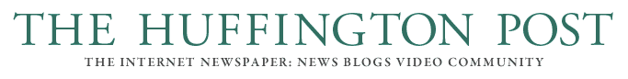








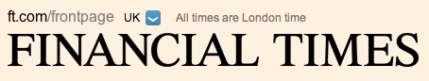
overloaded by news
“Representing Documents Through Their Readers”
Proceedings of the ACM Conference on Knowledge Discovery and
Data Mining (2013)
Khalid El-Arini, Min Xu, Emily Fox, Carlos Guestrin
https://dl.dropboxusercontent.com/u/16830382/papers/badgepaper-kdd2013.pdf
≥ 1 million news articles & blog posts generated every hour*
* [www.spinn3r.com]
Notes:
Spinn3r statistic

Slide 24


News Recommendation Engine
user
Vector representation:
Bag of words
LDA topics
etc.
corpus
Notes:
Animate the user in from the right

Slide 25
News Recommendation Engine
user
Vector representation:
Bag of words
LDA topics
etc.
corpus
Notes:
Animate the user in from the right

Slide 26

News Recommendation Engine
user
Vector representation:
Bag of words
LDA topics
etc.
corpus
Notes:
Animate the user in from the right

Slide 27

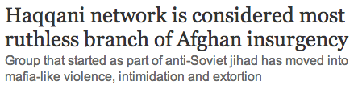
Challenge
Most common representations don’t naturally line up with user interests
Fine-grained representations (bag of words) too specific
High-level topics (e.g., from a topic model)
- too fuzzy and/or vague
- can be inconsistent over time

Slide 28
Goal
Improve recommendation performance through a more natural document representation

Slide 29
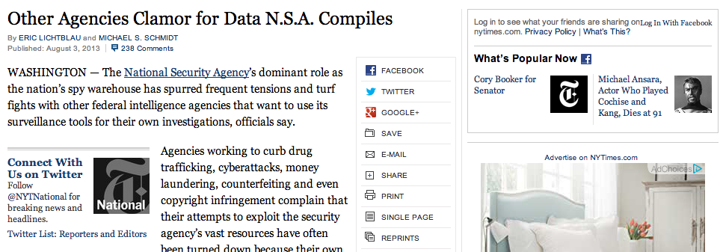
An Opportunity: News is Now Social
In 2012, Guardian announced more readers visit site via Facebook than via Google search

Slide 30
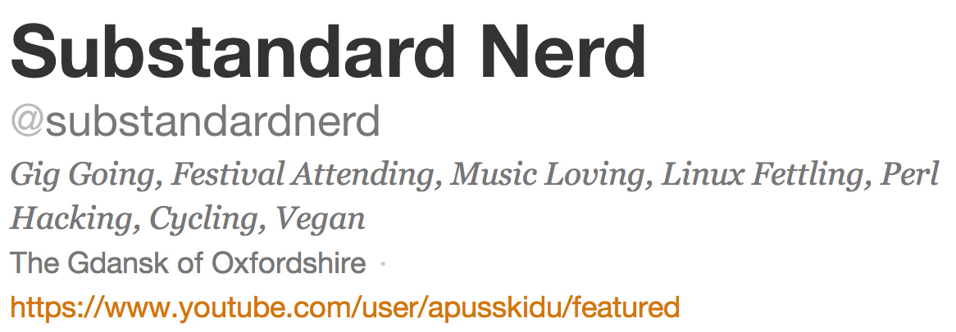
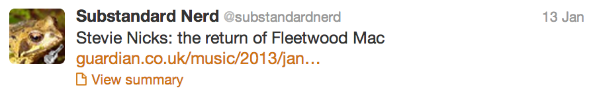
badges

Slide 31
Approach
Learn a document representation based on how readers publicly describe themselves

Slide 32
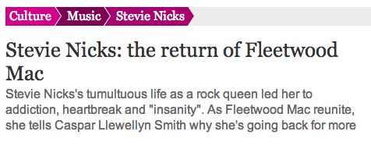

Slide 33
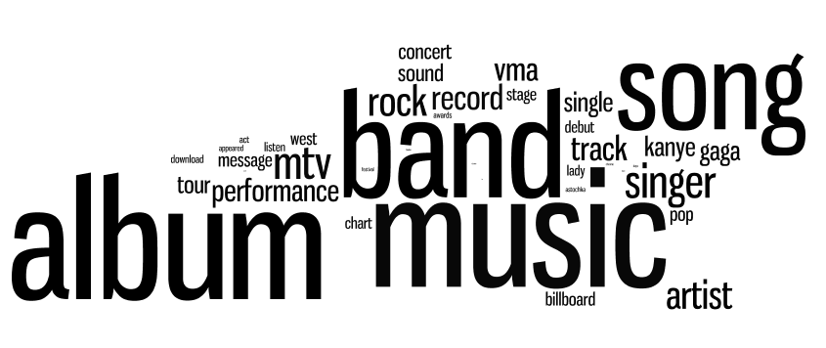
Using many tweets, can we learn that someone who identifies with
music
reads articles with these words:
via profile badges
?

Slide 34

Given: training set of tweeted news articles from a specific period of time
1. Learn a badge dictionary from training set
2. Use badge dictionary to encode new articles
3 million articles
music
words
badges

Slide 35
Advantages
Interpretable
Clear labels
Correspond to user interests
Higher-level than words

Slide 36
Advantages
Interpretable
Clear labels
Correspond to user interests
Higher-level than words
Semantically consistent over time
politics

Slide 37
Given: training set of tweeted news articles from a specific period of time
1. Learn a badge dictionary from training set
2. Use badge dictionary to encode new articles
3 million articles
music
words
badges

Slide 38
Dictionary Learning
Training data :
Identifies badges in Twitter profile of tweeter
Bag-of-words representation of document
album
Fleetwood Mac
love
Normalized!
Nicks
gig
music
cycling
linux

Slide 39
Dictionary Learning
Identifies badges in Twitter profile of tweeter
Bag-of-words representation of document
Training Objective:
“Dictionary”
“Encoding”

Slide 40
“Dictionary”
“Encoding”
Not convex! (because of BW term)
Convex if only optimize B or W (but not both)
Alternating Optimization (between B and W)
How to initialize?
Initialize:
gig
Use:
music
cycling
linux

Slide 41
Suppose Badge s often co-occurs with Badge t
B_{s} & B_{t} are correlated
From perspective of W, B’s are features.
Lasso tends to focus on one correlated feature
Graph Guided Fused Lasso:
Graph G of related Badges
Co-occurance Rate
On Twitter Profiles
Many articles might be about Gig, Festival & Music simultaneously.

Slide 42
Encoding New Articles
Badge Dictionary B is already learned
Given a new document j with word vector y_{j}
Learn Badge Encoding W_{j}:

Slide 43
Recap: Badge Dictionary Learning
1. Learn a badge dictionary from training set
2. Use badge dictionary to encode new articles
music
words
badges

Slide 44
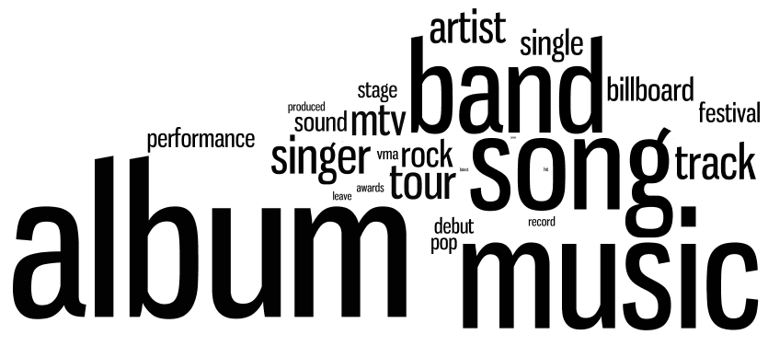
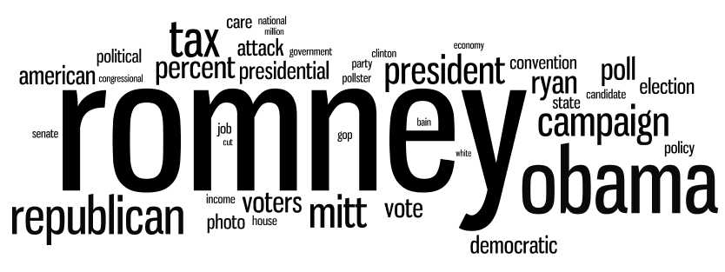
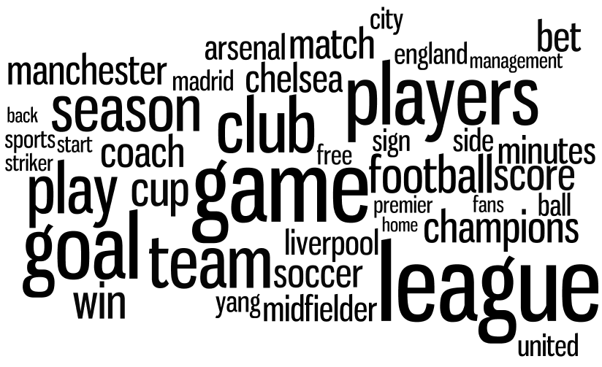
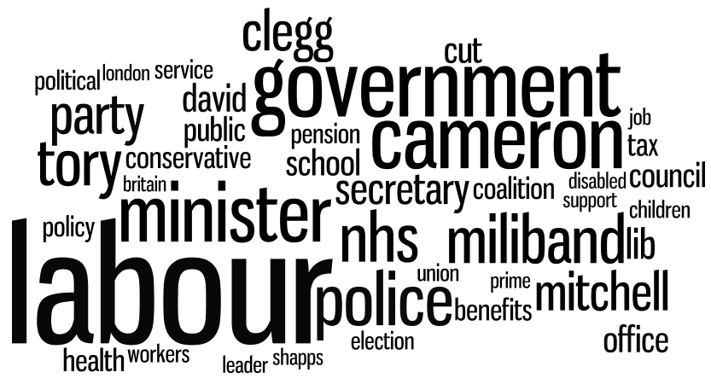
Examining B
September 2012
music
Biden
soccer
Labour
Notes:
Music
Soccer
Labour
Biden
tennis

Slide 45
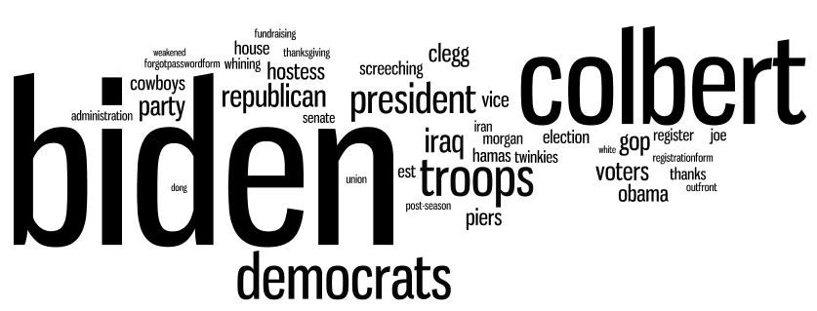
Badges Over Time
September 2012
music
Biden
September 2010
Notes:
Music
Soccer
Labour
Biden
tennis

Slide 46
A Spectrum of Pundits
“top conservatives on Twitter”
Limit badges to progressive and TCOT
Predict political alignments of likely readers?
more conservative
Took all articles by columnist
Looked at encoding score
progressive vs TCOT
Average

Slide 47
User Study
Which representation best captures user preferences over time?
Study on Amazon Mechanical Turk with 112 users
Show users random 20 articles from Guardian, from time period 1, and obtain ratings
Pick random representation
bag of words, high level topic, Badges
Represent user preferences as mean of liked articles
GOTO next time period
Recommend according to preferences
GOTO STEP 2

Slide 48
User Study
better
Bag of Words
High Level Topic
Badges

Slide 49
Recap: Personalization via twitter
Sparse Dictionary Learning
Learn a new representation of articles
Encode articles using dictionary
Better than Bag of Words
Better than High Level Topics
Based on social data
Badges on twitter profile & tweeting
Semantics not directly evident from text alone

Slide 50
Next Week
Sequence Prediction
Hidden Markov Models
Conditional Random Fields
Homework 1 due Tues 1/20 @5pm
via Moodle

